Slide 1
August
Monday | Tuesday | Wednesday | Thursday | Friday
 |  |  | 1 Day 1 | 2 Day 2
5 Day 3 | 6 Day 4 | 7 Day 5 | 8 Day 6 | 9 Day 1
12 Day 2 | 13 Day 3 | 14 Day 4 | 15 Day 5 | 16 Day 6
19 Day 1 | 20 Day 2 | 21 Day 3 | 22 Day 4 | 23 Day 5
26 Day 6 | 27 Day 1 | 28 Day 2 | 29 Day 3 | 30 Day 4

Slide 2
September
Monday | Tuesday | Wednesday | Thursday | Friday
2 No School | 3 Day 5 | 4 Day 6 | 5 Day 1 | 6 Day 2
9 Day 3 | 10 Day 4 | 11 Day 5 | 12 Day 6 | 13 Day 1
16 Day 2 | 17 Day 3 | 18 Day 4 | 19 Day 5 | 20 Day 6
23 Fall | 24 Break | 25 | 26 | 27
30 Day 1

Slide 3
October
Monday | Tuesday | Wednesday | Thursday | Friday
 | 1 Day 2 | 2 Day 3 | 3 Day 4 | 4 Day 5
7 Day 6 | 8 Day 1 | 9 Day 2 | 10 Day 3 | 11 Day 4
14 Day 5 | 15 Day 6 | 16 Day 1 | 17 Day 2 | 18 Day 3
21 Day 4 | 22 Day 5 | 23 Day 6 | 24 Day 1 | 25 Day 2
28 Day 3 | 29 Day 4 | 30 Day 5 | 31 Day 6
@MissSnydersClassroom

Slide 4
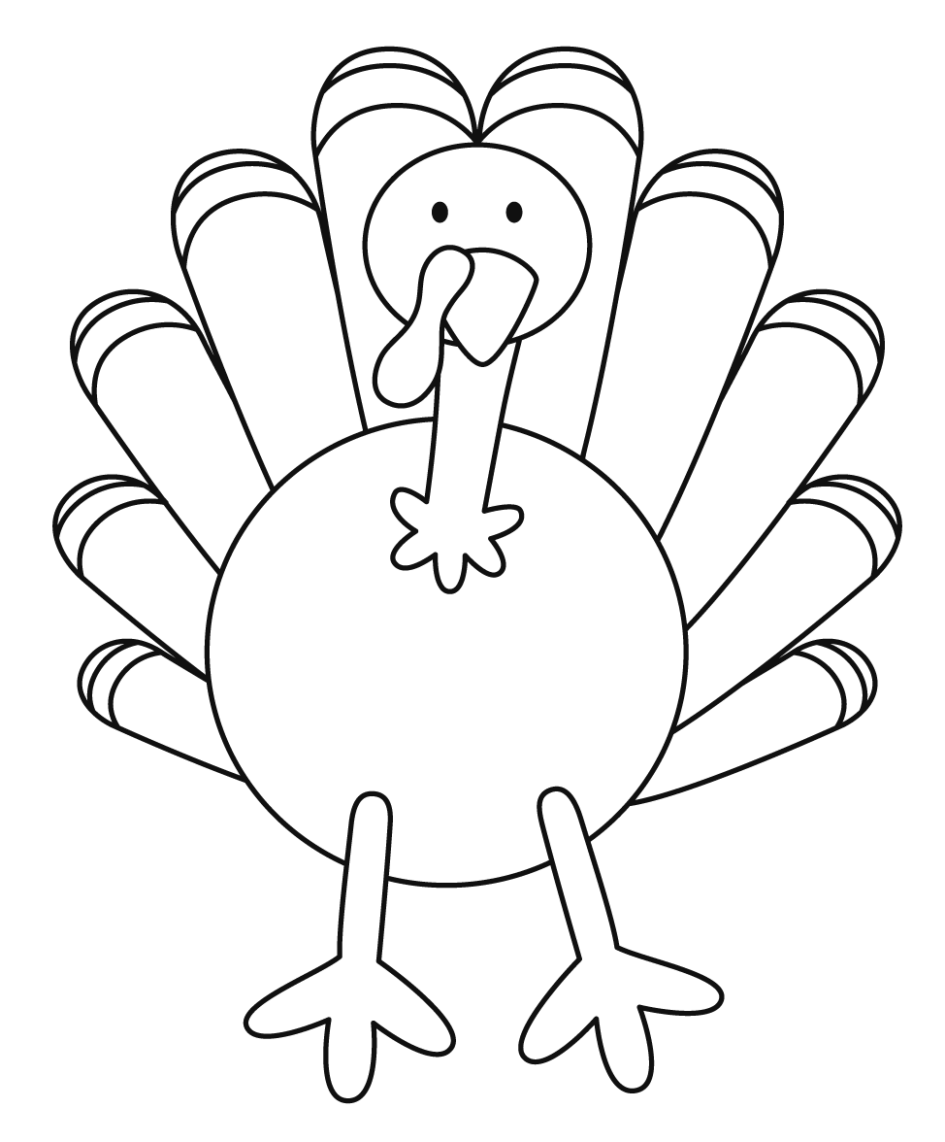
November
Monday | Tuesday | Wednesday | Thursday | Friday
 |  |  |  | 1 Day 1
4 Day 2 | 5 No School | 6 Day 3 | 7 Day 4 | 8 Day 5
11 Day 6 | 12 Day 1 | 13 Day 2 | 14 Day 3 | 15 Day 4
18 Day 5 | 19 Day 6 | 20 Day 1 | 21 Day 1 | 22 Day 3
25 No School | 26 | 27 | 28 Thanksgiving | 29

Slide 5
December
Monday | Tuesday | Wednesday | Thursday | Friday
2 Day 4 | 3 Day 5 | 4 Day 6 | 5 Day 1 | 6 Day 2
9 Day 3 | 10 Day 4 | 11 Day 5 | 12 Day 6 | 13 Day 1
16 Day 2 | 17 Day 3 | 18 Day 4 | 19 Day 5 | 20 Day 6
23 | 24 | 25 | 26 | 27
29 | 30 | 31

Slide 6
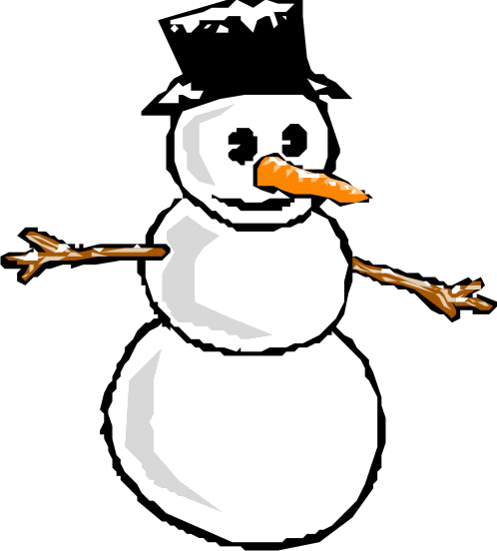
January
Monday | Tuesday | Wednesday | Thursday | Friday
 |  | 1 | 2 | 3
6 Day 1 | 7 Day 2 | 8 Day 3 | 9 Day 4 | 10 Day 5
13 Day 6 | 14 Day 1 | 15 Day 2 | 16 Day 3 | 17 Day 4
20 No School | 21 Day 5 | 22 Day 6 | 23 Day 1 | 24 Day 2
27 Day 3 | 28 Day 4 | 29 Day 5 | 30 Day 6 | 31 Day 1

Slide 7
February
Monday | Tuesday | Wednesday | Thursday | Friday
3 Day 2 | 4 Day 3 | 5 Day 4 | 6 Day 5 | 7 Day 6
10 Day 1 | 11 Day 2 | 12 Day 3 | 13 Day 4 | 14 Day 5
17 | 18 | 19 | 20 | 21
24 Day 6 | 25 Day 1 | 26 Day 2 | 27 Day 3 | 28 Day 4

Slide 8
March
Monday | Tuesday | Wednesday | Thursday | Friday
2 Day 5 | 3 Day 6 | 4 Day 1 | 5 Day 2 | 6 Day 3
9 Day 4 | 10 Day 5 | 11 Day 6 | 12 Day 1 | 13 Day 2
16 Day 3 | 17 Day 4 | 18 Day 5 | 19 Day 6 | 20 Day 1
23 Day 2 30th Day 1 | 24 Day 3 31st Day 2 | 25 Day 4 | 26 Day 5 | 27 Day 6

Slide 9
April
Monday | Tuesday | Wednesday | Thursday | Friday
 |  | 1 Day 3 | 2 Day 4 | 3 Day 5
6 Spring Break | 7 | 8 | 9 | 10
13 Day 6 | 14 Day 1 | 15 Day 2 | 16 Day 3 | 17 Day 4
20 Day 5 | 21 Day 6 | 22 Day 1 | 23 Day 2 | 24 Day 3
27 Day 4 | 28 Day 5 | 29 Day 6 | 30 Day 1

Slide 10
May
Monday | Tuesday | Wednesday | Thursday | Friday
 |  |  |  | 1 Day 2
4 Day 3 | 5 Day 4 | 6 Day 5 | 7 Day 6 | 8 Day 1
11 Day 2 | 12 Day 3 | 13 Day 4 | 14 Day 5 | 15 Day 6
18 Day 1 | 19 Day 2 | 20 Day 3 | 21 | 22
25 | 26 | 27 | 28 | 29

